Slide 1
Lesson 8
2 Dimensional Array – Nested Lists

Slide 2


Slide 3

A table with 4 rows and 4 columns

Slide 4
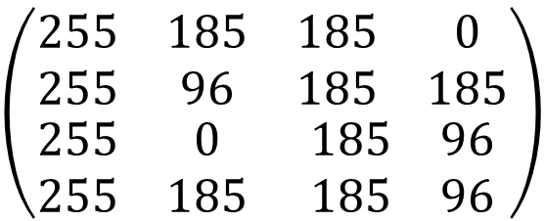
Representing . . .
A table with 4 rows and 4 columns
255 | 185 | 185 | 0
255 | 96 | 185 | 185
255 | 0 | 185 | 96
255 | 185 | 185 | 96
We can represent a table with n rows and m columns into a n by m matrix.
$$\left(\begin{matrix}\begin{matrix}255 & 185 \\ 255 & 96\end{matrix} & \begin{matrix}185 & 0 \\ 185 & 185\end{matrix} \\ \begin{matrix}255 & 0 \\ 255 & 185\end{matrix} & \begin{matrix}185 & 96 \\ 185 & 96\end{matrix}\end{matrix}\right)$$
n rows (horizontal)
by
m columns (vertical)

Slide 5
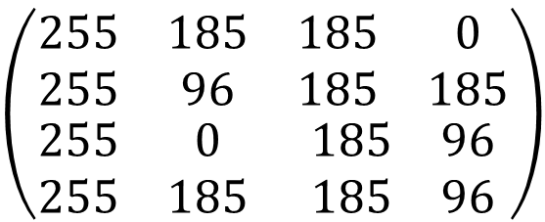
A Matrix to a 2 dimensional array
[[255,185,185,0],
[255,96,185,185],
[255,0,185,96],
[255,185,185,96]]
$$\left(\begin{matrix}\begin{matrix}255 & 185 \\ 255 & 96\end{matrix} & \begin{matrix}185 & 0 \\ 185 & 185\end{matrix} \\ \begin{matrix}255 & 0 \\ 255 & 185\end{matrix} & \begin{matrix}185 & 96 \\ 185 & 96\end{matrix}\end{matrix}\right)$$
Nested lists in Python: a list in a list

Slide 6
Lesson Objective
manipulate two dimensional array : nested lists
using matrix as example

Slide 7
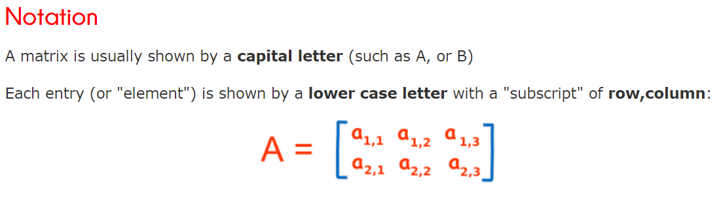
Notation of Matrix

Slide 8
Operations and Methods to Matrices
print
finding maximum
addition , subtraction
scalar multiplication
transpose
matrix multiplication (if possible)

Slide 9
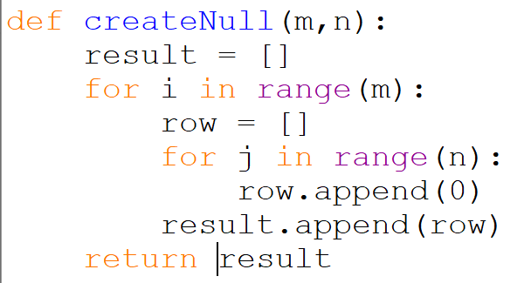
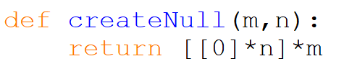
creating a null matrix : matrix with all 0
creating a m row by n column null matrix
if m = n, the matrix will be square
a matrix need not be square
this does not work. Why?
so how?

Slide 10
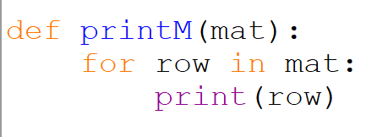
printing a matrix
printing a matrix row by row:

Slide 11
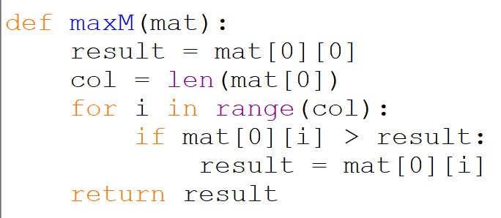
finding maximum value in a matrix :
for a 1 by n matrix:
How to generalize it to a m by n matrix ?

Slide 12
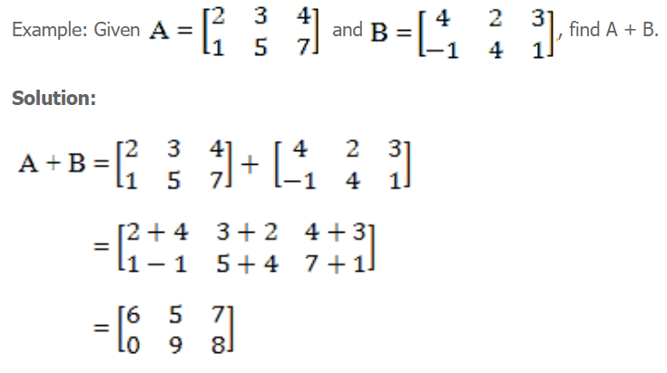
Matrix Addition

Slide 13
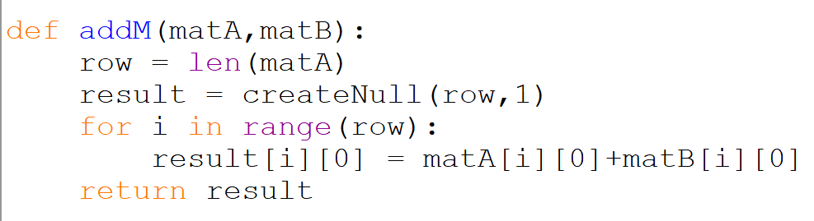
Matrix Addition
How to generalize it to a m by n matrix ?
How to subtract ?
for a m by 1 matrix:

Slide 14
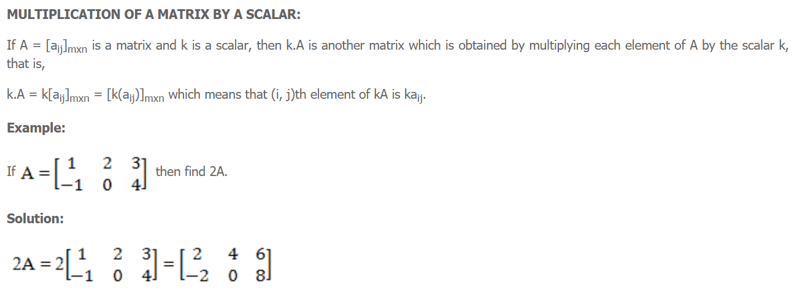
Scalar Multiplication
Write a function scalarM that takes in a matrix and a scalar and outputs the scalar multiplication ?

Slide 15
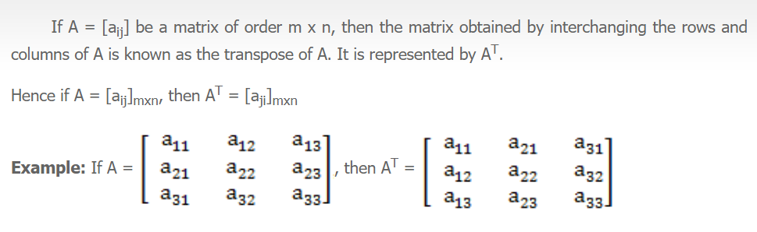
Transpose of a Matrix
Write a function transpose that takes in a matrix and returns the transpose of the matrix.

Slide 16
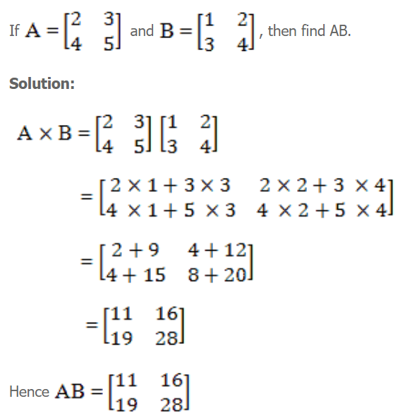
Matrix Multiplication
For more examples:
https://www.mathsisfun.com/algebra/matrix-multiplying.html
1st row and 1st column
If A is a p by q matrix and B is a q by r matrix,
AB is a p by r matrix
If A is a 3 by 4 matrix and B is a 4 by 2 matrix,
AB is a 3 by 2 matrix
Write a function multiplication that takes in two matrices and returns the multiplication of the two matrices.

Slide 17
Work to do . . .
8A – List
8B – List 2
Programming Assignment 7 : Matrix 1

